Slide 1
Technical Analysis of Vehicle Network

Slide 2
Contents
1. What is Vehicle Network?
2. CAN
3. CAN FD
4. LIN
5. FlexRay
6. Ethernet
7. Summary

Slide 3
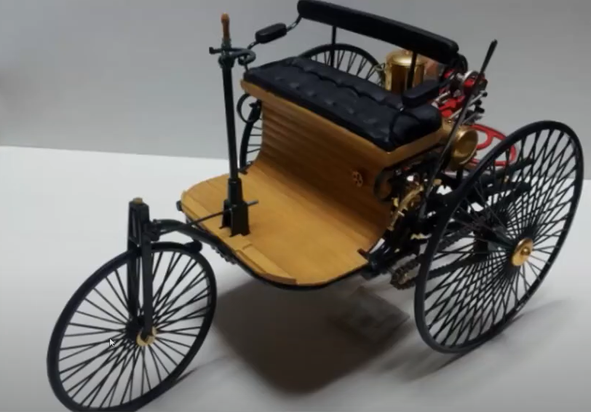
Past : Every component part of vehicle is independent with each other which means there are no needs to transfer data
1. What is Vehicle Network?

Slide 4
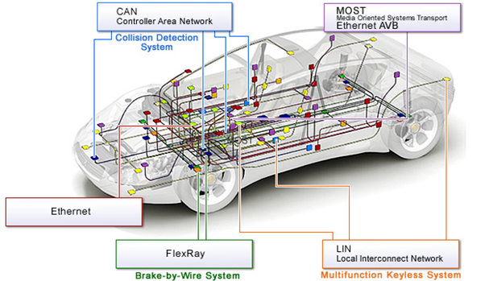
Present : Every component of vehicle is now connected so firmly. Therefore communicating data with each part is inevitable. So, we use Vehicle Network(i.e., CAN, CAN-FD, LIN, Ethernet etc) to communicate data
1. What is Vehicle Network?

Slide 5
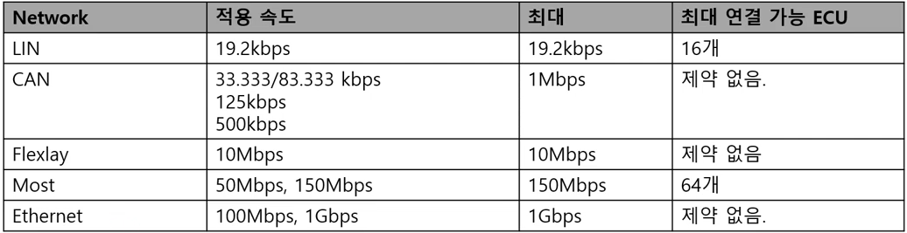
1. What is Vehicle Network?
Average Transfer Rate
Maximum Transfer Rate
Maximum number of ECU connectivity

Slide 6
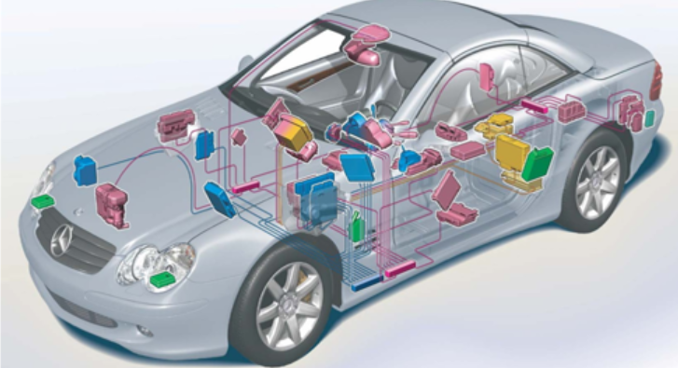
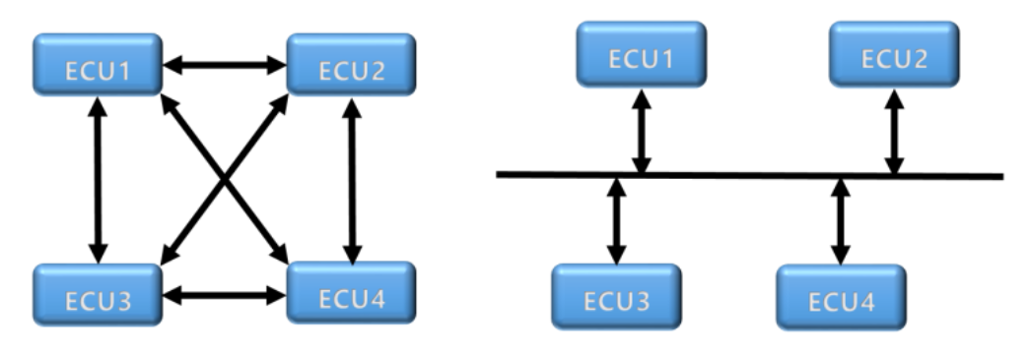
2. CAN(Controller Area Network)
(1) Definition : CAN is used to connect each of ECU(Electronic Control Unit)
Before CAN
After CAN
Before CAN, ECUs are communicating with each other independently and each of them were connected with others only by one wire. Thus, it enhanced the complexity of the system. So, it was necessary to use only one wire to connect multiple ECUs in parallel. This wire is called BUS.

Slide 7
(2) Advantages
-Multi Master communication : CAN BUS is used by multiple master so that masters can share it in real time.
-Simple Structure : It uses only two signals(CAN_High, CAN_Low). So it is very simple to add more modules if it`s necessary.
-Strong enough against noises : It uses only two signals. So it is very strong against electrical noises.
-Priority Sorting using ID : Every ECU has its own ID. CAN uses ID as priorities. It enhances the speed of system controlling and the safety of system.
-High-speed and long-distance communication : CAN offer 500k~1M bps of speed and 1000m as a maximum distance communication
-PLUG&PLAY : It offers PLUG & PLAY function which makes CAN controller be easier to connect with BUS and remove from BUS

Slide 8
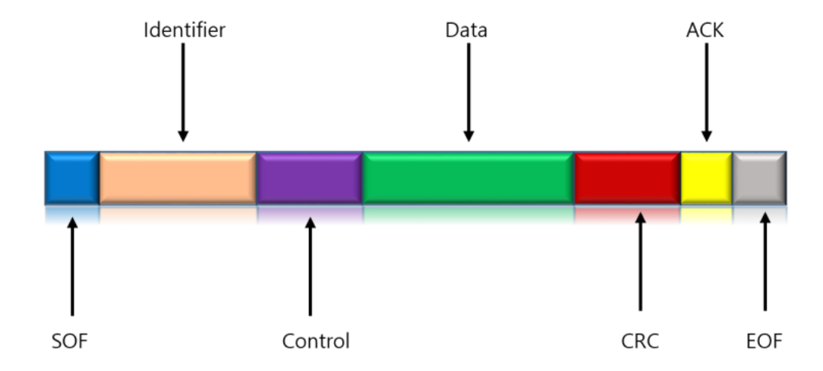
2. CAN(Controller Area Network)
(3) CAN Frame Structure
-SOF(Start Of Frame) : Representing the start of message to synchronize nodes of BUS
-Identifier(ID) : Used to identify messages and give priority number. Standard CAN uses 11 bits and Extended CAN uses 29 bits to represent ID
-Control : Used to represent the length of data
-Data : Data which is being transferred in this frame
-CRC : Used to check errors of frame
-ACK : Used to send the receive notification of message
- EOF(End Of Frame) : Representing the end of frame

Slide 9
(4) Principles Of Operations Of CAN
CAN BUS Cycle->Next CAN BUS Cycle->Next CAN BUS Cycle ->…
(5) CAN BUS Cycle
CAN controller`s checking of CAN BUS`s usage at the moment->ID(Unique for Each of every ECU) priority checking->Lower is more prior->Execution of next CAN BUS Cycle
(6) Utilities of CAN
CAN can be used in various industries from automobile to automatic machines
(7) Future of CAN
Appearance of CAN FD to complement problems of CAN

Slide 10
3. CAN FD(Controller Area Network with Flexible Data rate)
(1)Problems of CAN
CAN doesn`t have an enough transmission rate(bit rate) and data length. So, to solve this problem, there was a need to use faster network which can send larger data.
And BOSH invented CAN-FD by extending CAN on 2012.

Slide 11
3. CAN FD(Controller Area Network with Flexible Data rate)
(2) Difference of CAN and CAN-FD
Increasement of Data length : 8byte(CAN)->64byte(CAN FD)
Increasement of Data rate : 100kbps~5Mbps
Increasement of Data security : CRC(Cyclic Redundancy Check) Field increase

Slide 12
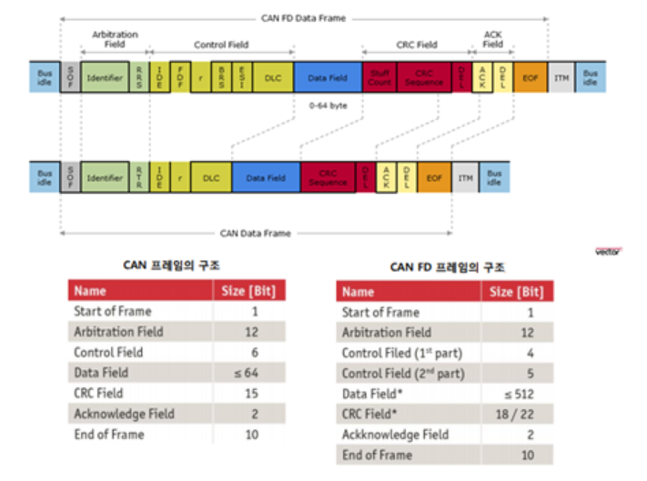
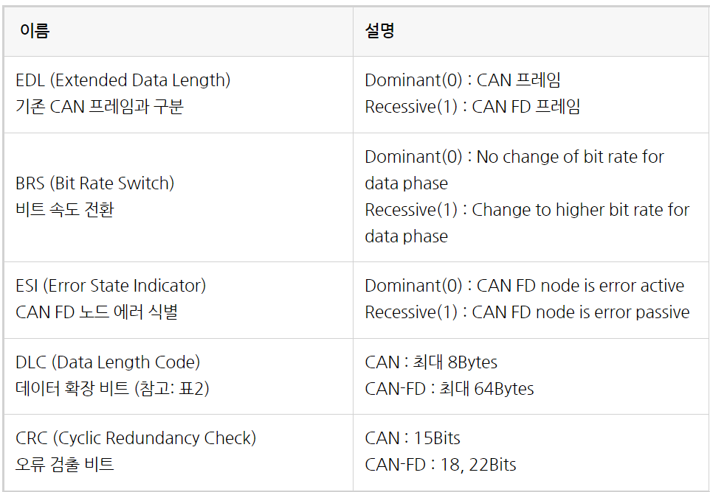
3. CAN FD(Controller Area Network with Flexible Data rate)
(3) CAN-FD Protocol
-Control Field : 6bit->9bit
-Data Field : 8bit->64bit

Slide 13
4. LIN(Local Interconnect Network)
(1)Appearance of LIN
CAN(Good for transferring data in a high speed and in a high bandwidth But lower cost effectiveness) vs LIN(Higher cost-effectiveness)
(2) Usage and Difference of LIN compared to CAN
LIN is used in vehicle ECU and active sensor/actuator. Unlike CAN, LIN is composed of only one master and lots of slaves. But it is much simpler than CAN which leads to the cost-efficiency. In reality, LIN is used as an assistant of CAN like sunroof, mirror which doesn`t require high performance.

Slide 14
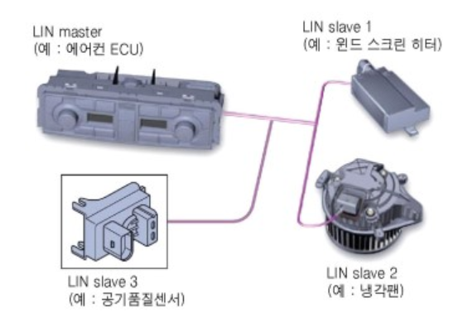
4. LIN(Local Interconnect Network)
ECU becomes the master and active sensor/actuator becomes the slave.
*Role of master and slave
-master : Decide which packet to transfer and when to transfer
-Slave : Follow master`s orders
For example,

Slide 15
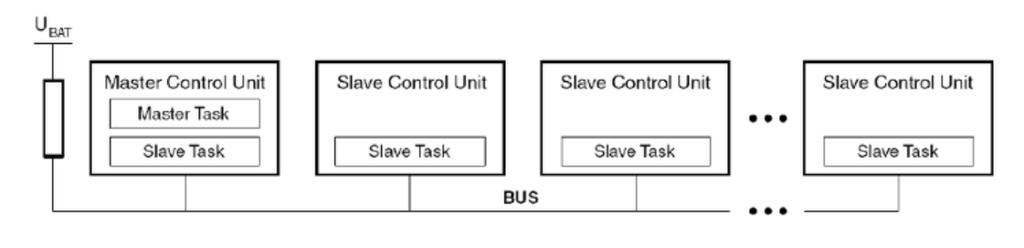
4. LIN(Local Interconnect Network)
*Structure of LIN : only one master and many slaves all connected with BUS

Slide 16
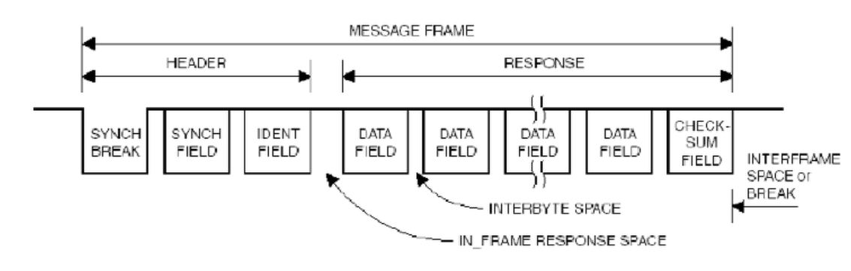
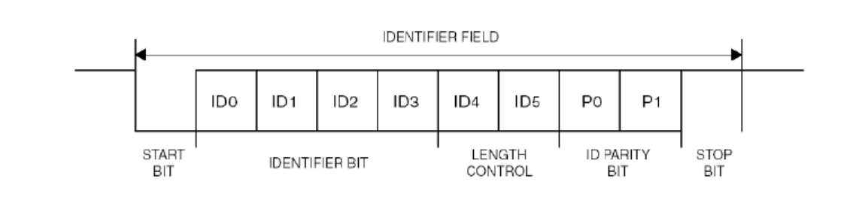
4. LIN(Local Interconnect Network)
(3) Frame of LIN
SYNCH BREAK : Informing beginning of message
SYNCH FIELD : 5 falling edges to synchronize slave`s clock
with master`s clock
IDENT FIELD : 10 bits to identify what the packet is

Slide 17
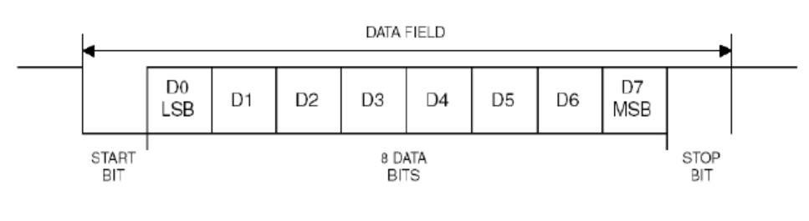
4. LIN(Local Interconnect Network)
Data Field : 8bits but only second-sixth bits are available.
Check-sum Field : 8 bits to check validity of messages

Slide 18
5. FlexRay
(1) Appearance of FlexRay
Because of complexity of control systems and sensors in vehicle, CAN is not effective as data get more massive. So, we need to use faster network technology to handle with massive data. And here comes FlexRay.
(2) Characteristics of FlexRay
-Fast : maximum transfer rate is 10Mbps
-Use TTP(Time Triggered Protocol) but it sometimes cause the waste of bandwidth. To lessen the waste of bandwidth, we use ETP(Event Triggered Protocol) at the same time.

Slide 19
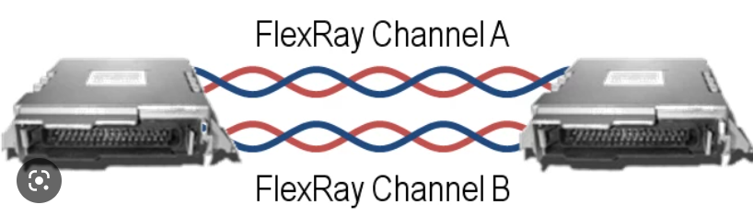
5. FlexRay
(3) Usage of FlexRay
It is used in Brake System, Cruise Control where requires data safety.

Slide 20
6. Ethernet
(1) Appearance of Ethernet
FlexRay faced a new problem. As the transfer rate faster, the more wires are used which lead into the increasement of weight of car. Furthermore, smart car(i.e. Connected car) requires faster network than FlexRay.
(2) Characteristics of FlexRay
-Super fast : maximum transfer rate is 10times faster than FlexRay.
-Use switch and CSMA/CD

Slide 21
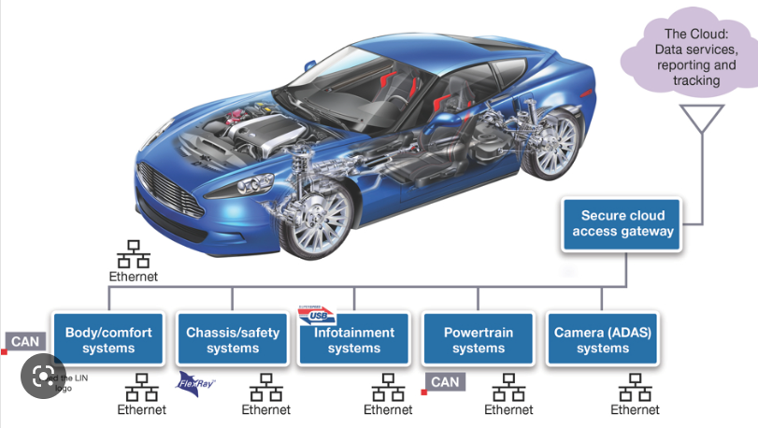
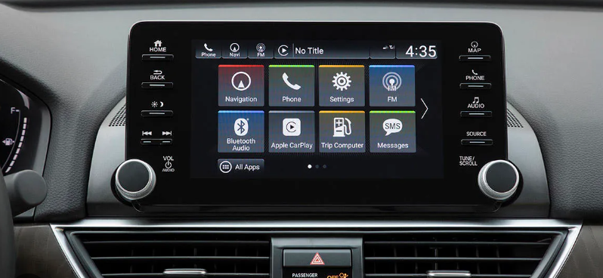
6. Ethernet
(3) Usage of Ethernet
Infortainment system which connects users with vehicle using video and audio.

Slide 22
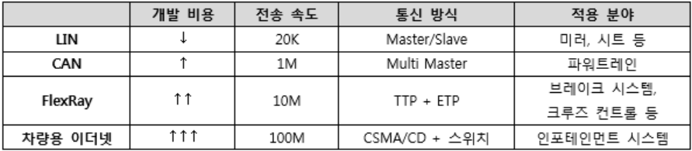
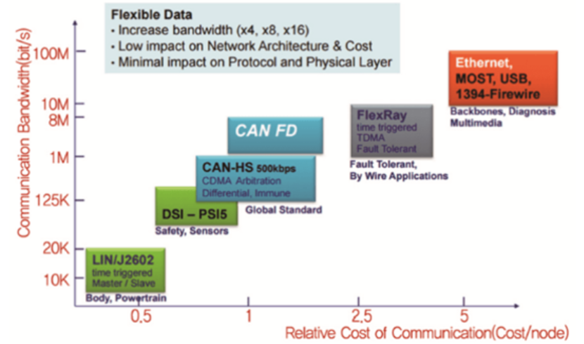
7. Conclusion
*Conclusion
There are various network used in vehicle.
All of these networks are used differently in different parts of vehicle for different purposes.

